Slide 1
Chapter 8: Main Memory

Slide 2
Chapter 8: Memory Management
Background
Swapping
Contiguous Memory Allocation
Paging
Structure of the Page Table
Segmentation
Example: The Intel Pentium

Slide 3
Objectives
To provide a detailed description of various ways of organizing memory hardware
To discuss various memory-management techniques, including paging and segmentation
To provide a detailed description of the Intel Pentium, which supports both pure segmentation and segmentation with paging

Slide 4
Background
Program must be brought (from disk) into memory and placed within a process for it to be run
Main memory and registers are the only storage - CPU can access directly
Memory unit only sees a stream of addresses + read requests, or address + data and write requests
Register access in one CPU clock (or less)
Main memory can take many cycles
Cache sits between main memory and CPU registers
Protection of memory required to ensure correct operation

Slide 5
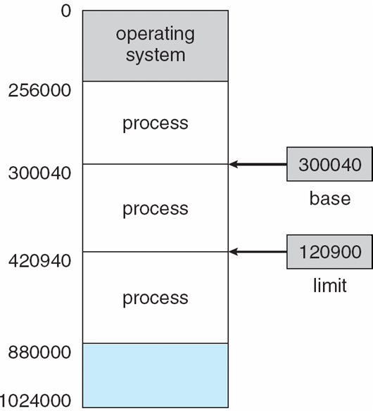
Base and Limit Registers
A pair of base and limit registers define the logical address space

Slide 6
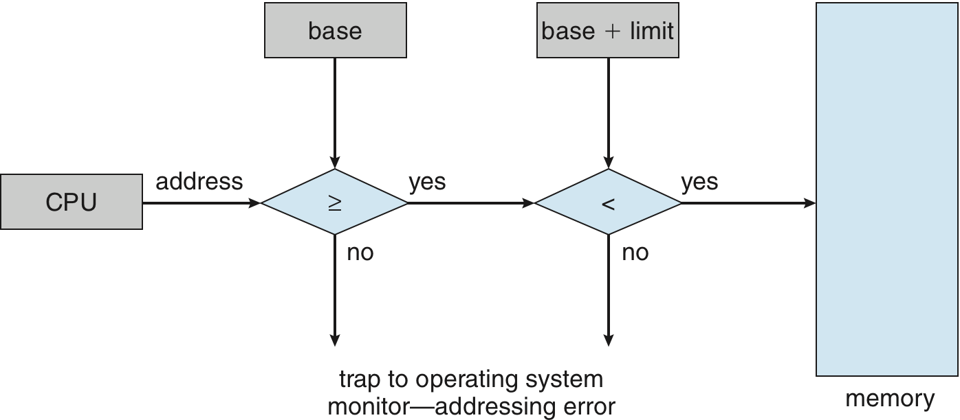
Hardware Address Protection with Base and Limit Registers

Slide 7
Address Binding
Inconvenient to have first user process physical address always at 0000
How can it not be?
Further, addresses represented in different ways at different stages of a program’s life
Source code addresses usually symbolic
Compiled code addresses bind to relocatable addresses
i.e. “14 bytes from beginning of this module”
Linker or loader will bind relocatable addresses to absolute addresses
i.e. 74014
Each binding maps one address space to another

Slide 8
Binding of Instructions and Data to Memory
Address binding of instructions and data to memory addresses can happen at three different stages
Compile time: If memory location known a priori at compile time, absolute code can be generated; must recompile code if starting location changes ( where process resides in memory)
Load time: If it is not known at compile time where the process will reside in memory then the compiler must generate relocatable code. In this case the final binding is delayed until load time. If the starting address changes we need only reload the user code to incorporate this changed value.
Execution time: Binding delayed until run time if the process can be moved during its execution from one memory segment to another
Need hardware support for address maps (e.g., base and limit registers)

Slide 9
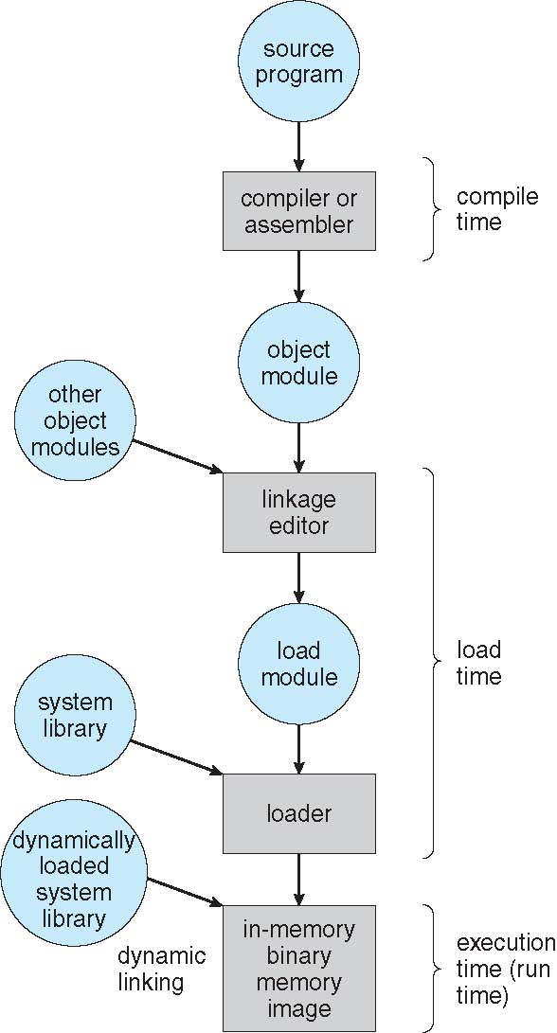
Multistep Processing of a User Program

Slide 10
Logical vs. Physical Address Space
The concept of a logical address space that is bound to a separate physical address space is central to proper memory management
Logical address – generated by the CPU; also referred to as virtual address
Physical address – address seen by the memory unit loaded into the memory address register.
Logical and physical addresses are the same in compile-time and load-time address-binding schemes; logical (virtual) and physical addresses differ in execution-time address-binding scheme
Logical address space is the set of all logical addresses generated by a program
Physical address space is the set of all physical addresses generated by a program
The run time mapping from virtual to physical addresses id one by a hardware device called the memory management unit (MMU). Next is the illustration of this mapping with a simple MMU scheme which is a generalization of the base register scheme shown above.

Slide 11
Memory-Management Unit (MMU)
Hardware device that at run time maps virtual to physical address
Many methods possible, covered in the rest of this chapter
To start, consider simple scheme where the value in the relocation register is added to every address generated by a user process at the time it is sent to memory
Base register now called relocation register
MS-DOS on Intel 80x86 used 4 relocation registers
The user program deals with logical addresses; it never sees the real physical addresses
Execution-time binding occurs when reference is made to location in memory
Logical address bound to physical addresses
Therefor we have two different types of addresses :logical address (range 0 to max) and physical addresses (in the range R+0 to R+max for base value of R)

Slide 12
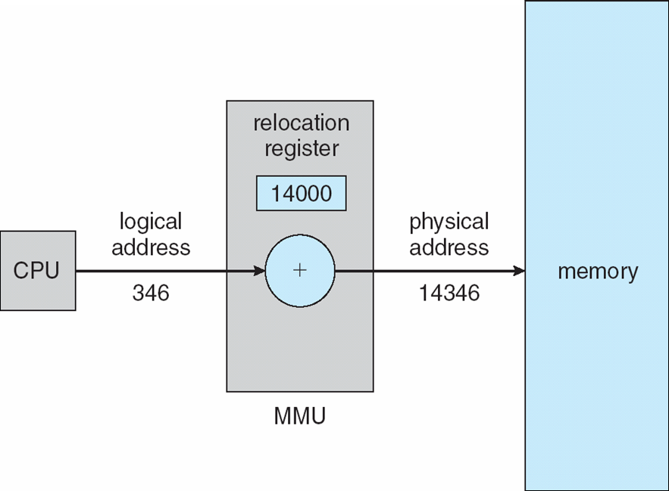
Dynamic relocation using a relocation register

Slide 13
Dynamic Loading
Routine is not loaded until it is called
Better memory-space utilization; unused routine is never loaded
All routines kept on disk in relocatable load format
Useful when large amounts of code are needed to handle infrequently occurring cases
No special support from the operating system is required
Implemented through program design
OS can help by providing libraries to implement dynamic loading

Slide 14
Dynamic Linking
Static linking – system libraries and program code combined by the loader into the binary program image
Dynamic linking –linking postponed until execution time
Small piece of code, stub, used to locate the appropriate memory-resident library routine
Stub replaces itself with the address of the routine, and executes the routine
Operating system checks if routine is in processes’ memory address
If not in address space, add to address space
Dynamic linking is particularly useful for libraries
System also known as shared libraries
Consider applicability to patching system libraries
Versioning may be needed

Slide 15
Swapping
A process can be swapped temporarily out of memory to a backing store, and then brought back into memory for continued execution
Total physical memory space of processes can exceed physical memory
Backing store – fast disk large enough to accommodate copies of all memory images for all users; must provide direct access to these memory images
Roll out, roll in – swapping variant used for priority-based scheduling algorithms; lower-priority process is swapped out so higher-priority process can be loaded and executed
Major part of swap time is transfer time; total transfer time is directly proportional to the amount of memory swapped
System maintains a ready queue of ready-to-run processes which have memory images on disk or in the memory and are ready to run.
Does the swapped out process need to swap back in to same physical addresses?
Depends on address binding method
Plus consider pending I/O to / from process memory space
Modified versions of swapping are found on many systems (i.e., UNIX, Linux, and Windows)
Swapping normally disabled
Started if more than threshold amount of memory allocated
Disabled again once memory demand reduced below threshold

Slide 16

Schematic View of Swapping

Slide 17
Context Switch Time including Swapping
If next processes to be put on CPU is not in memory, need to swap out a process and swap in target process
Context switch time can then be very high
100MB process swapping to hard disk with transfer rate of 50MB/sec
Plus disk latency of 8 ms
Swap out time of 2008 ms
Plus swap in of same sized process
Total context switch swapping component time of 4016ms (> 4 seconds)
Can reduce if reduce size of memory swapped – by knowing how much memory really being used
System calls to inform OS of memory use via request memory and release memory

Slide 18
Constraints of Swapping
If we want to swap a process we must be sure that is completely idle. P1 in queue to access the I/O device. But Device is busy. Now if P1 is swapped by P2 and the I/O device is ready it may use the memory now used by P2.
Solution: Never swap a process with pending I/o or execute I/o Operations only into OS buffers. Since transfers between OS buffers and process memory then occur only when the process is swapped in.
Swapping required considerable amount of time. So a new variant of swapping is used i.e.
Swapping is normally disabled but will start if many processes are running and are using a threshold amount of memory.

Slide 19
Contiguous Allocation
Main memory usually into two partitions:
Resident operating system, usually held in low memory with interrupt vector
User processes then held in high memory
Each process contained in single contiguous section of memory
Relocation registers used to protect user processes from each other, and from changing operating-system code and data
Base register contains value of smallest physical address
Limit register contains range of logical addresses – each logical address must be less than the limit register
MMU maps logical address dynamically
Can then allow actions such as kernel code being transient and kernel changing size

Slide 20

Hardware Support for Relocation and Limit Registers

Slide 21
Contiguous Allocation (Cont.)
One of the simplest methods for allocating memory is to divide memory into several fixed-sized partitions. Each partition may contain exactly one process.
Multiple-partition allocation
Degree of multiprogramming limited by number of partitions
Hole – block of available memory; holes of various size are scattered throughout memory
When a process arrives, it is allocated memory from a hole large enough to accommodate it
Process exiting frees its partition, adjacent free partitions combined
Operating system maintains information about: a) allocated partitions b) free partitions (hole)
OS
OS
OS
OS
process 5
process 5
process 5
process 5
process 9
process 9
process 8
process 10
process 2
process 2
process 2
process 2

Slide 22
One more method MVT where we have a generalization of the fixed partition scheme.
In the variable partition scheme, the OS keeps a table indicating which parts of memory are available and which parts are occupied. Initially all memory are available for user processes and is considered on large block of available memory i.e. hole.
Here the memory blocks available comprise a set of holes of various sizes scattered throughout memory. When a process arrives and needs memory the system searches the set for a hole that is large enough for the process.
If the hole is too large, it is split into two parts. One to the arriving process, the other returned to the set of holes.
If the process terminates its block of memory is placed back into the set of holes.
If the new hole is adjacent to other holes, these holes merge to form one larger hole.
This is dynamic storage allocation.
Problem is how to satisfy a request of size n from list of free holes
Solution:
First fit
Best fit
Worst fit

Slide 23
Dynamic Storage-Allocation Problem
How to satisfy a request of size n from a list of free holes?
First-fit: Allocate the first hole that is big enough
Best-fit: Allocate the smallest hole that is big enough; must search entire list, unless ordered by size
Produces the smallest leftover hole
Worst-fit: Allocate the largest hole; must also search entire list
Produces the largest leftover hole
First-fit and best-fit better than worst-fit in terms of speed and storage utilization

Slide 24
Fragmentation
External Fragmentation – total memory space exists to satisfy a request, but it is not contiguous
Internal Fragmentation – allocated memory may be slightly larger than requested memory; this size difference is memory internal to a partition, but not being used
First fit analysis reveals that given N blocks allocated, 0.5 N blocks lost to fragmentation
1/3 may be unusable -> 50-percent rule

Slide 25
Fragmentation (Cont.)
Reduce external fragmentation by compaction
Shuffle memory contents to place all free memory together in one large block
Compaction is possible only if relocation is dynamic, and is done at execution time
I/O problem
Latch job in memory while it is involved in I/O
Do I/O only into OS buffers
Now consider that backing store has same fragmentation problems
Another solution to the external fragmentation is to permit the logical address space of the processes to be noncontiguous, thus allowing a process to be allocated physical memory wherever such memory is available.

Slide 26
Given memory partitions of 100KB, 500KB, 200KB, 300KB, 600KB (in order), how would each of the first fit, best fit and worst fit algorithms place processes of 212KB, 417KB,112KB and 426KB (in order). Which algorithm makes the most efficient use of memory?
Show it diagramtically.

Slide 27
First Fit:
212K is put in 500K partition
417K is put in 600K partition
112K is put in 288K partition (500-212)
426K must wait.
Best Fit:
212K is put in 300K partition
417K is put in 500K partition
112K is put in 200K partition
426K is put in 600K partition
Worst Fit
212K is put in 600K partition
417K is put in 500K partition
112K is put in 388K partition (600-212)
426K must wait.

Slide 28
Paging
Physical address space of a process can be noncontiguous; process is allocated physical memory whenever the latter is available
Divide physical memory into fixed-sized blocks called frames
Size is power of 2, between 512 bytes and 16 Mbytes. Easy for translation of logic to physical. Logical memory address space is 2^{m} and page size is 2^{n} addressing units.
Divide logical memory into blocks of same size called pages
Keep track of all free frames
To run a program of size N pages, need to find N free frames and load program
Set up a page table to translate logical to physical addresses
Backing store likewise split into pages
Still have Internal fragmentation

Slide 29
Address Translation Scheme
Address generated by CPU is divided into:
Page number (p) – used as an index into a page table which contains base address of each page in physical memory
Page offset (d) – combined with base address to define the physical memory address that is sent to the memory unit
For given logical address space 2^{m} and page size 2^{n}
page number
page offset
p
d
m - n
n

Slide 30
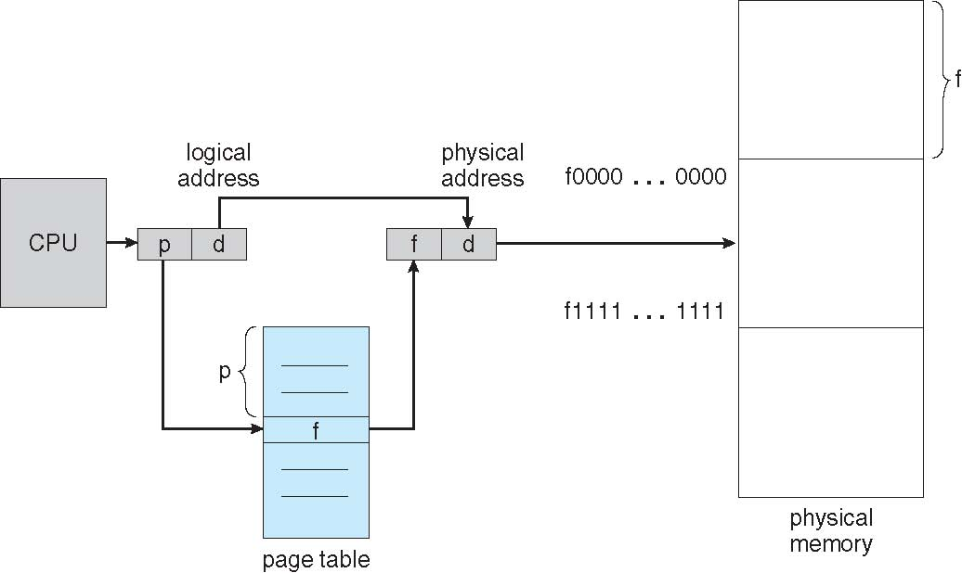
Paging Hardware

Slide 31

Paging Model of Logical and Physical Memory

Slide 32

Paging Example
n=2 and m=4 32-byte memory and 4-byte pages

Slide 33
Paging (Cont.)
Calculating internal fragmentation
Page size = 2,048 bytes
Process size = 72,766 bytes
35 pages + 1,086 bytes
Internal fragmentation of 2,048 - 1,086 = 962 bytes
Worst case fragmentation = 1 frame – 1 byte
On average fragmentation = 1 / 2 frame size
So small frame sizes desirable?
But each page table entry takes memory to track
Page sizes growing over time
Solaris supports two page sizes – 8 KB and 4 MB

Slide 34
Process view and physical memory now very different
By implementation process can only access its own memory
Frame table
OS needs to maintain a copy of IR, Register contents and page table.
Page table used by CPU dispatcher to define the hardware page table when a process is to be allocated the CPU.
Paging therefore increases context switch time.

Slide 35

Free Frames
Before allocation
After allocation

Slide 36
Implementation of Page Table
Many ways to implement Page table.
Each process has a page table
Each page table can be implemented as set of dedicated registers which are built with high speed logic to make the paging address translation efficient.
But this is satisfied if page table is very small.
Another Method:
Page-table base register (PTBR) points to the page table
Page-table length register (PTLR) indicates size of the page table
In this scheme every data/instruction access requires two memory accesses
One for the page table and one for the data / instruction

Slide 37
The two memory access problem can be solved by the use of a special fast-lookup hardware cache called associative memory or translation look-aside buffers (TLBs)
Some TLBs store address-space identifiers (ASIDs) in each TLB entry – uniquely identifies each process to provide address-space protection for that process (during context switch to avoid mismatch)
Otherwise need to flush at every context switch
TLBs typically small (64 to 1,024 entries)
On a TLB miss, value is loaded into the TLB for faster access next time
Replacement policies must be considered
Some entries can be wired down for permanent fast access

Slide 38
Associative Memory
Associative memory – parallel search
Address translation (p, d)
If p is in associative register, get frame # out
Otherwise get frame # from page table in memory
Page #
Frame #

Slide 39

Paging Hardware With TLB

Slide 40
Effective Access Time
Associative Lookup = ε time unit
Can be < 10% of memory access time
Hit ratio = α
Hit ratio – percentage of times that a page number is found in the associative registers; ratio related to number of associative registers
Consider α = 80%, ε = 20ns for TLB search, 100ns for memory access
Effective Access Time (EAT)
EAT = (1 + ε) α + (2 + ε)(1 – α)
= 2 + ε – α
Consider α = 80%, ε = 20ns for TLB search, 100ns for memory access
EAT = 0.80 x 120 + 0.20 x 220 = 140ns
Consider slower memory but better hit ratio -> α = 98%, ε = 20ns for TLB search, 140ns for memory access
EAT = 0.98 x 160 + 0.02 x 300 = 162.8ns

Slide 41
Memory Protection
Memory protection implemented by associating protection bit with each frame to indicate if read-only or read-write access is allowed
Can also add more bits to indicate page execute-only, and so on during translation to be checked instead of wasting time.
Valid-invalid bit attached to each entry in the page table:
“valid” indicates that the associated page is in the process’ logical address space, and is thus a legal page
“invalid” indicates that the page is not in the process’ logical address space
Or use PTLR
Any violations result in a trap to the kernel
Eg for 14 bit address space (0-16383) and program that should use only addresses 0 to 10468. Given page size 2KB.

Slide 42

Valid (v) or Invalid (i) Bit In A Page Table
There is a problem due to internal fragmentation in last page. Only addresses from 12288 to 16383 are invalid. Due to 2KB page size. Rarely programs may use the entire page space. Therefore we have PTLR to indicate the size of the page table for each process whose test will cause an error trap to OS checked against every logical address.

Slide 43
Shared Pages
Shared code
One copy of read-only (reentrant) code shared among processes (i.e., text editors, compilers, window systems)
Eg. Support 40users with text editor which has 150KB of code and 50KB data space. In total 8000 KB required. But using shared pages we can reduce.
Similar to multiple threads sharing the same process space
Also useful for interprocess communication if sharing of read-write pages is allowed
Private code and data
Each process keeps a separate copy of the code and data
The pages for the private code and data can appear anywhere in the logical address space

Slide 44
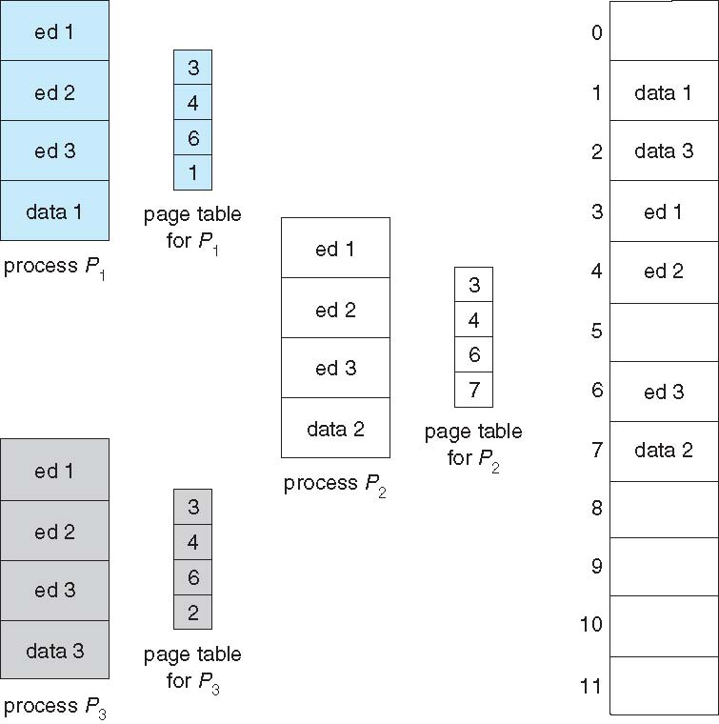
Shared Pages Example
Now we require only 2150KB instead of 8000KB.(150+40*50)

Slide 45
Structure of the Page Table
Memory structures for paging can get huge using straight-forward methods
Consider a 32-bit logical address space as on modern computers
Page size of 4 KB (2¹²)
Page table would have 1 million entries (2³² / 2¹²⁾
If each entry is 4 bytes -> 4 MB of physical address space / memory for page table alone
That amount of memory used to cost a lot
Don’t want to allocate that contiguously in main memory
Hierarchical Paging
Hashed Page Tables
Inverted Page Tables

Slide 46
Hierarchical Page Tables
Break up the logical address space into multiple page tables
A simple technique is a two-level page table
We then page the page table

Slide 47

Two-Level Page-Table Scheme

Slide 48
Two-Level Paging Example
A logical address (on 32-bit machine with 4K page size) is divided into:
a page number consisting of 20 bits
a page offset consisting of 12 bits
Since the page table is paged, the page number is further divided into:
a 10-bit page number
a 12-bit page offset
Thus, a logical address is as follows:
where p₁ is an index into the outer page table, and p₂ is the displacement within the page of the inner page table
Known as forward-mapped page table
page number
page offset
p₁
p₂
d
10
10
12

Slide 49

Address-Translation Scheme

Slide 50
64-bit Logical Address Space
Even two-level paging scheme not sufficient
If page size is 4 KB (2¹²)
Then page table has 2⁵² entries
If two level scheme, inner page tables could be 2¹⁰ 4-byte entries
Address would look like
Outer page table has 2⁴² entries
One solution is to add a 2nd outer page table
But in the following example the 2nd outer page table is still 2³² entries in size
And possibly 4 memory access to get to one physical memory location
outer page
inner page
page offset
p₁
p₂
d
42
10
12

Slide 51


Three-level Paging Scheme

Slide 52
Hashed Page Tables
Common in address spaces > 32 bits
The virtual page number is hashed into a page table
This page table contains a chain of elements hashing to the same location
Each element contains (1) the virtual page number (2) the value of the mapped page frame (3) a pointer to the next element
Virtual page numbers are compared in this chain searching for a match
If a match is found, the corresponding physical frame is extracted

Slide 53

Hashed Page Table

Slide 54
A variation of the above scheme that is favorable for 64 bit address spaces has been proposed.
This variation uses clustered page tables which are similar to hashed page tables except that each entry in the hast table refers to several pages than a single page.
These are useful for sparse address spaces where memory references are noncontagious and scattered throughout the address space.

Slide 55
Inverted Page Table
Rather than each process having a page table and keeping track of all possible logical pages, track all physical pages. Since page table have many entries and page table takes large amount of space.
One entry for each real page of memory
Entry consists of the virtual address of the page stored in that real memory location, with information about the process that owns that page
Decreases memory needed to store each page table, but increases time needed to search the table when a page reference occurs
Use hash table to limit the search to one — or at most a few — page-table entries
TLB can accelerate access
But how to implement shared memory?
One mapping of a virtual address to the shared physical address

Slide 56

Inverted Page Table Architecture

Slide 57
Segmentation
Memory-management scheme that supports user view of memory
A program is a collection of segments
A segment is a logical unit such as:
main program
procedure
function
method
object
local variables, global variables
common block
stack
symbol table
arrays

Slide 58
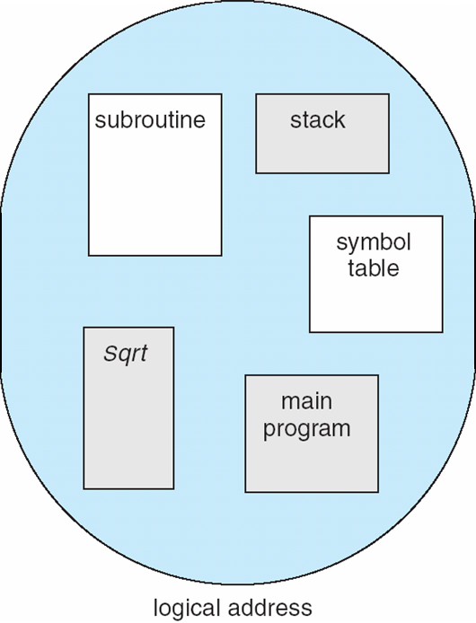
User’s View of a Program

Slide 59
Logical View of Segmentation
1
1
4
2
3
4
2
3
user space
physical memory space

Slide 60
Segmentation Architecture
Logical address consists of a two tuple:
<segment-number, offset>,
Segment table – maps two-dimensional physical addresses; each table entry has:
base – contains the starting physical address where the segments reside in memory
limit – specifies the length of the segment
Segment-table base register (STBR) points to the segment table’s location in memory
Segment-table length register (STLR) indicates number of segments used by a program;
segment number s is legal if s < STLR

Slide 61
Segmentation Architecture (Cont.)
Protection
With each entry in segment table associate:
validation bit = 0 ⇒ illegal segment
read/write/execute privileges
Protection bits associated with segments; code sharing occurs at segment level
Since segments vary in length, memory allocation is a dynamic storage-allocation problem
A segmentation example is shown in the following diagram

Slide 62
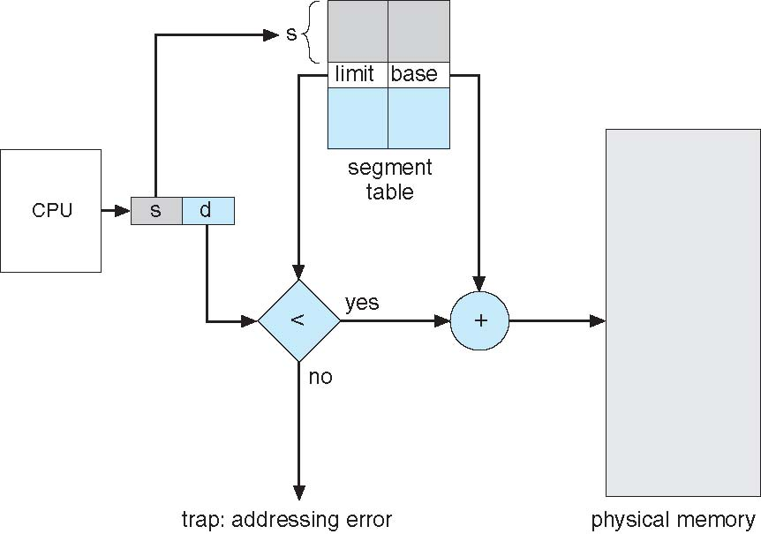
Segmentation Hardware

Slide 63
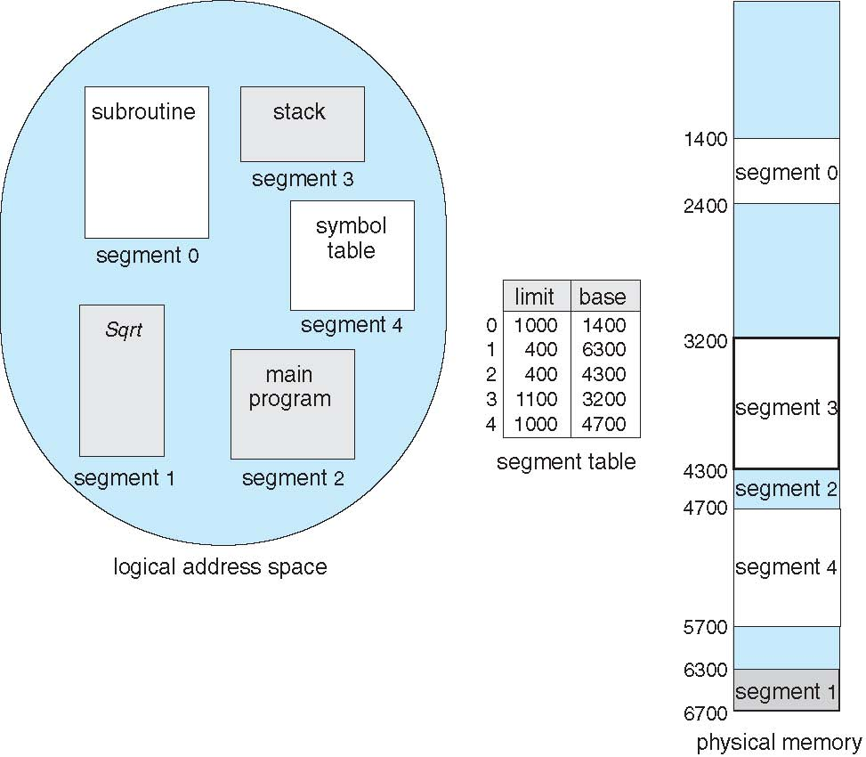
Example of Segmentation

Slide 64
Example: The Intel Pentium
Supports both segmentation and segmentation with paging
Each segment can be 4 GB
Up to 16 K segments per process
Divided into two partitions
First partition of up to 8 K segments are private to process (kept in local descriptor table LDT)
Second partition of up to 8K segments shared among all processes (kept in global descriptor table GDT)
CPU generates logical address
Given to segmentation unit
Which produces linear addresses
Linear address given to paging unit
Which generates physical address in main memory
Paging units form equivalent of MMU
Pages sizes can be 4 KB or 4 MB

Slide 65
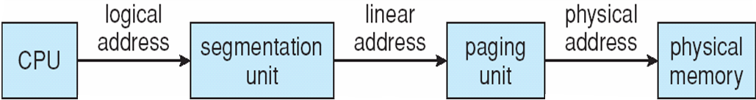
Logical to physical address translation in Pentium

Slide 66
Logical address of segmentation
Each entry in the LDT and GDT consists of an 8 byte segment descriptor with detailed information about a particular segment, including the base location and limit of that segment
The logical address is a pair (selector, offset) where the selector is a 16 bit number.
13bits- s
1 bit-g
2 bits- p
S gives the segment number, g indicates whether the segment is in GDT or LDT and p deals with protection.
Offset is a 32 bit number specifying the location of the byte or word within the segment in question.
The machine has 6 segment registers, allowing six segments to be addressed at any one time by a process.
It also has size 8 byte microprogram registers to hold the corresponding descriptors from either LDT or GDT.
This cache lets the Pentium avoid having to read the descriptor from memory for every memory reference.

Slide 67
Linear address of Paging
The linear address on Pentium is 32 bits long and is formed as follows:
The segment register points to the appropriate entry in LDT or GDT.
The base and limit information about the segment in question is used to generate a linear address.
First the limit is used to check for address validity.
If the address is not valid, a memory fault is generated resulting in trap to OS.
If valid, then the value of offset is added to the value of the base, resulting in 32 bit linear address.

Slide 68
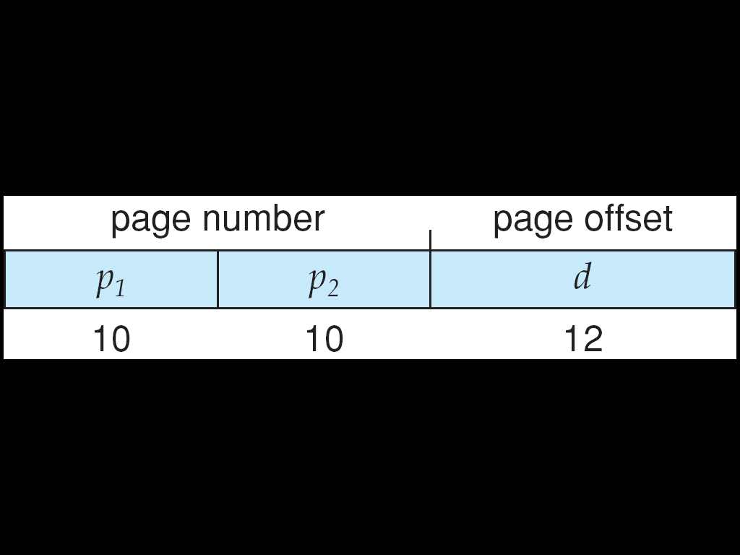
Logical to Physical Address Translation in Pentium

Slide 69
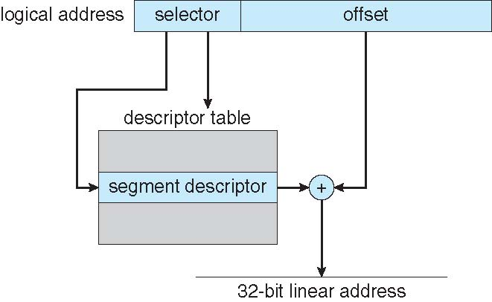
Intel Pentium Segmentation

Slide 70
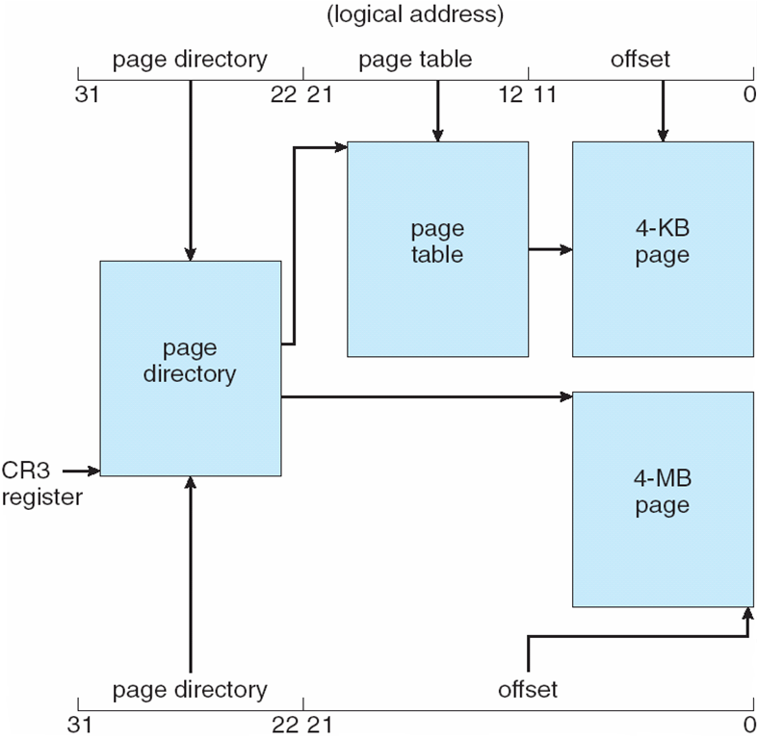
Pentium Paging Architecture
One entry in page directory is the page size which if set indicates that the size of the page frame is 4MB else
4KB. If this flag is set the page directory points directly to the 4MB page frame bypassing the inner page
table and the 22 low order bits in the linear address refer to the offset in the 4MB page frame.

Slide 71

Linear Address in Linux
Linux uses only 6 segments (kernel code, kernel data, user code, user data, task-state segment (TSS), default LDT segment)
Linux only uses two of four possible modes – kernel and user
Uses a three-level paging strategy that works well for 32-bit and 64-bit systems
Linear address broken into four parts:
But the Pentium only supports 2-level paging?!

Slide 72
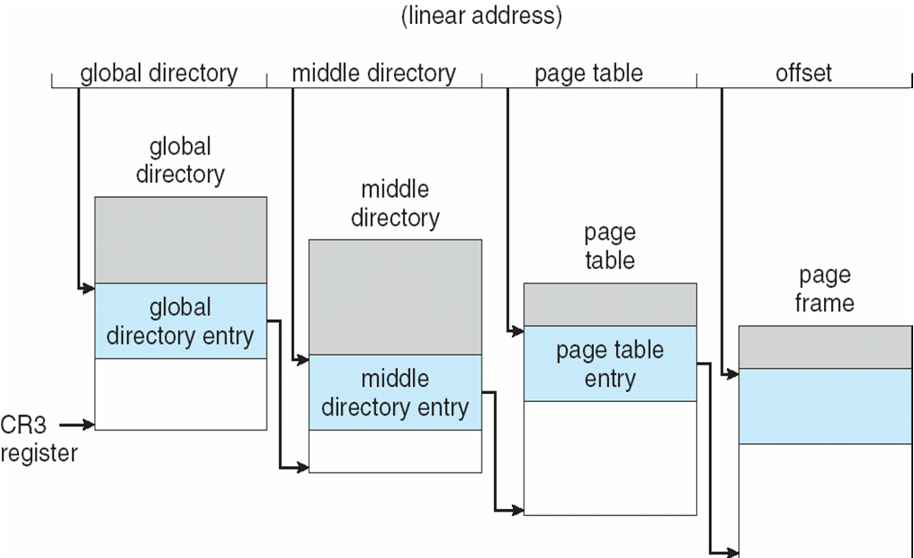
Three-level Paging in Linux

Slide 73
End of Chapter 7

